Slide 1
TREACHER COLLINS SYNDROME: A CLINICAL AND MOLECULAR STUDY BASED ON A LARGE SERIES OF PATIENTS
By Vincent et al
Presented by Joyce Wang’ombe

Slide 2
CONTENT
Introduction
Aim of the study
Materials and methods
Results
Discussion
Critique

Slide 3
INTRODUCTION
Treacher Collins syndrome (TCS) is also known as Franceschetti-Zwahlen-Klein syndrome
It is a rare genetic condition affecting the way the face develops
It belongs to a larger group of disorders called mandibulofacial dysostosis (MFD)
Treacher Collins syndrome is the most common among Mandibulofacial dysostosis occurring in 1 in 50, 000 births

Slide 4
INTRODUCTION
TERM | DEFINITION
Mandibulofacial dysostosis | Abnormalities of the facial bones
Malar and mandibular hypoplasia | Under development of cheek and lower jaw bone
Downward slanting palpebral fissures | Drooping of the eye lids
Coloboma of the lower eyelid | V-shaped lower eyelid
Microtia | Having abnormal small ears
Choanal atresia | Blocking of the nasal air way
Aural atresia | Absence of the ear canal
Nail hypoplasia | Nails are absent
Rachis malformation | Malformation of the spine
Intubation/ tracheostoma | Artificial ventilation into the trachea

Slide 5
INTRODUCTION
TCS is characterized by typical bilateral facial features such as:
Malar and mandibular hypoplasia
Downward slanting palpebral fissures
Coloboma of the lower eyelid
Microtia
Conductive hearing loss
Intellectual disability is rarely reported and no visceral or skeletal malformations have been reported

Slide 6
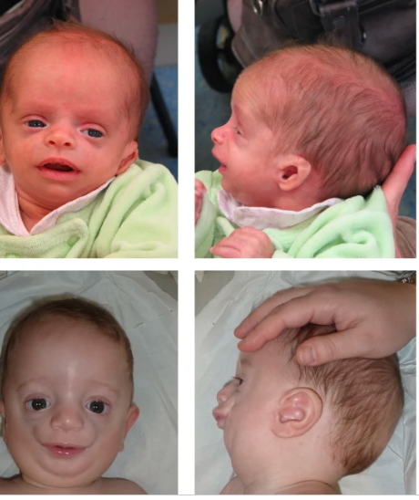
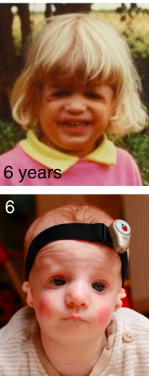
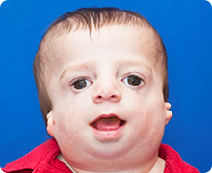
INTRODUCTION
Treacher Collins syndrome features in children

Slide 7
INTRODUCTION
Treacher Collins syndrome is genetically heterogeneous and three genes are involved:
TCOF1 and POLR1D- autosomal dominant
POLR1D and POLR1C – autosomal recessive
TCOF1 is the major gene involved
It encodes Treacle, a nucleolar phosphoprotein involved in production of ribosomal RNA
This protein is active during early embryonic development in structures that become bones and other tissues of the face

Slide 8
INTRODUCTION
POLR1D and POLR1C encode subunits of RNA polymerase 1 and 3 respectively
Heterozygous intragenic deletions in TCOF1 have been described as rare causes of TCS
No correlations between phenotypic variability and location of mutations in TCOF1 have been established

Slide 9
INTRODUCTION
They also investigated another gene EFTUD2 which had been identified in patients with Mandibulofacial dysostosis and microcephaly or type Guion- Almeida
Guion-Almeida is characterized by severe microcephaly, intellectual disability, choanal, eosophageal and aural atresia, cleft palate and congenital heart defects
In another study it was investigated that mutation in this gene caused MFD without microcephaly

Slide 10
AIM OF THE STUDY
They investigated clinical features in patients assessed for Treacher Collins syndrome and performed molecular screening of the four genes: TCOF1, POLR1D, POLR1C, and EFTUD2; in order to establish genotype- phenotype correlations

Slide 11
MATERIALS AND METHODS
Clinical data and DNA samples were obtained from 146 patients: 71 males and 75 females
The age range was from birth to 40 years old
76% of patients were from France, Guadeloupe and Reunion islands
24% from Belgium, Hungary, Lithuania, Morocco, Portugal, Spain and Switzerland
The physician had to complete a form identifying 19 clinical features

Slide 12
MATERIALS AND METHODS
The patients were also put into two groups namely: typical and atypical Treacher Collins syndrome (TCS)
Typical TCS patients presented with the characteristic facial ‘gestalt’, including mandibular and malar hypoplasia, downward slanting palpebral fissures, lower eyelid coloboma and microtia
Atypical TCS patients were defined by the presence of intellectual disability, microcephaly, anomaly of the limbs, and organ malformation (except cardiac)

Slide 13
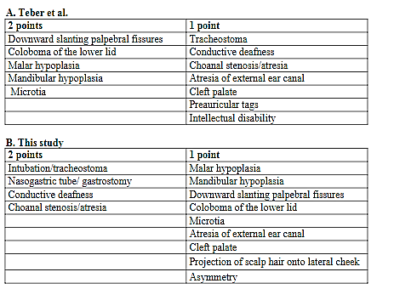
MATERIALS AND METHODS
In addition they also came up with a severity score for the clinical features
Mildly affected ≤8, and severely affected ≥9

Slide 14
MATERIALS AND METHODS
The patients were screened for the 4 genes using different methods:
Direct sequencing by Sanger methods
Multiplex ligation-dependent probe amplification analysis
Array-comparative genomic hybridization
Denaturing high pressure liquid chromatography
A statistical analysis using the chi-square test was performed to establish any relation between two qualitative variables

Slide 15
MATERIALS AND METHODS
They first investigated variants in the TCOF1 gene by Sanger sequencing
In the absence of a point mutation, they looked for large rearrangements by Multiplex ligation-dependent probe amplification (MLPA)
In the absence of molecular anomaly in the TCOF1 gene they investigated the POLR1D and POLR1C genes by Sanger sequencing and MLPA
If these three genes were normal or if an abnormality was detected by MLPA, they analyzed the patients by array-CGH
If microcephaly, intellectual disability or esophageal atresia were described, they analyzed the EFTUD2 gene by Sanger sequencing as first line

Slide 16
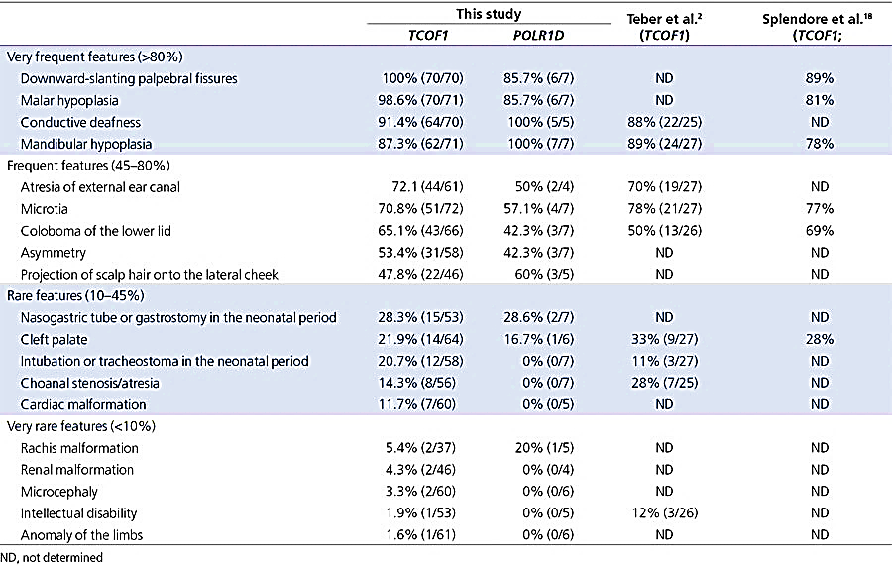
RESULTS

Slide 17
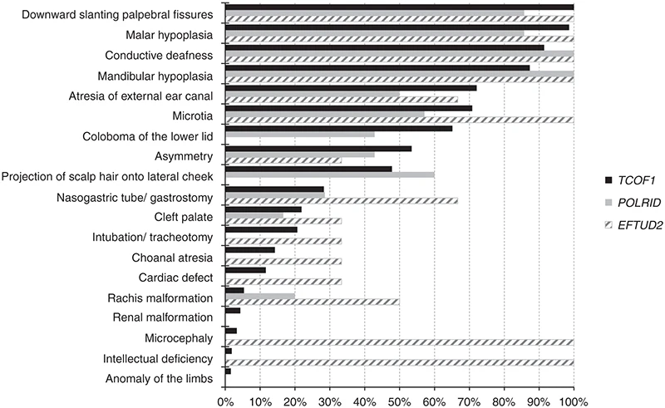
RESULTS
Frequency of clinical findings in patients with mutations in TCOF1, POLR1D , and EFTUD2.

Slide 18
RESULTS
CLINICAL DATA
In patients with mutations in TCOF1, 7 had cardiac malformation
Intellectual disability was present in one patient
One patient had nail hypoplasia
Mean severity score for the phenotype in TCOF1 of 7.5
In POLR1D, mutations one patient had severe scoliosis
Mean severity score for the phenotype in POLR1D of 7

Slide 19
RESULTS
MOLECULAR STUDIES
Results for all the patients
They found 101/146 patients positive for TCOF1 and POLR1D and no mutation in POLR1C
Out of the 11 analyzed for EFTUD2 gene, 4 patients had molecular abnormalities
92 patients had mutations in TCOF1 gene and 47 were novel
85/92 were predicted to lead to a premature stop codon as result of frameshift mutation

Slide 20
RESULTS
MOLECULAR STUDIES
Similar to Teber et al. findings, frameshift mutation was the most frequent with 58/92 patients
The common 5bp deletion in exon 24 in previous studies occurred in 7/92 of the patients
2 patients exhibited large deletions encompassing several genes including TCOF1
Among the 92 patients with molecular abnormalities in TCOF1, 27/92 were familial cases, 47/92 were sporadic cases, and 29/92 were de novo mutations

Slide 21
RESULTS
MOLECULAR STUDIES
Extreme intrafamilial variability was observed with either mutations in TCOF1 and POLR1D mutations
There was an inherited mutation in 2 out of 6 patients referred to as sporadic in TCOF1 and 4 in POLR1D
In Familial cases 18 mutations were inherited from the mother and 6 from the father
One father had somatic mosaicism; about 30% mosaicism

Slide 22
RESULTS
MOLECULAR STUDIES
Two coding domains were distinguished: LisH exon 1-2 domain and Treacle domain exon 2 -24
4 mutations were found in LisH domain and 89/92 were found in the Treacle domain except for a hotspot in exon 24 which had 17/92 of the mutations
There were 9 patients with anomalies in POLR1D

Slide 23
RESULTS
PHENOTYPE GENOTYPE CORRELATION
No significant association between any of the clinical features and the two genes studied was noted
There was no significant association between the genotype and the degree of severity
No specific association occurred when the phenotype was scored as typical or atypical in TCOF1 mutations
In TCOF1 the severity of the TCS phenotype was not significantly different whatever the mutation

Slide 24
RESULTS
PHENOTYPE GENOTYPE CORRELATION
Regarding mutations in LisH or treacle domain there was no association with the clinical features or degree of severity
Among the 7 patients with cardiac defect, the mutations were all located in the TCOF1 gene
There were two large deletions identified encompassing TCOF1 and other genes in patients that had typical TCS and Intellectual disability

Slide 25
RESULTS
PHENOTYPE GENOTYPE CORRELATION
19 SNPs were identified
One SNP specifically studied (rs28372960) was present in 6 patients but there was no correlation of it with the clinical features or severity of the disease
All patients with EFTUD2 gene had microcephaly, malar and mandibular hypoplasia, deafness, downward slanting palpebral fissures and microtia
One patient had esophageal atresia and a complex cardiac malformation
Patients with mutations in POLR1D had mild features and no life threatening complications

Slide 26
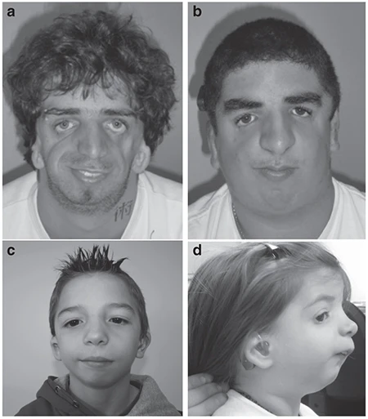
RESULTS
Front or lateral view of four patients from the series.
(a) Patient with a heterozygous missense mutation in TCOF1
(b) Patient with an intragenic deletion of TCOF1
(c) Patient with a missense mutation in POLR1D
(d) Patient with complete deletion of POLR1D

Slide 27
DISCUSSION
In this study they analyzed clinical data including additional features that had not been previously described and molecular data of 3 genes involved in the syndrome
A high rate of congenital cardiac defects in patients with mutations in TCOF1 8% were observed
Intellectual disability(ID) was observed in only one patient hence confirming that (ID) is not a feature of TCS
Due to extreme intrafamilial variation observed, this study suggests verifying inheritance of the mutation even for asymptomatic parents

Slide 28
DISCUSSION
The fact that the high rate of SNPs was detected and no association with any of the 19 clinical features suggests the implication of other factors
In the study by Teber et al. the severity score was based on the overall facial features.
This study suggested evaluating the severity based on functional impairment and level of intervention required
Among the 45 Patients with no mutations in TCOF1, POLR1D and POLR1C, 6 patients had typical Treacher Collins syndrome features suggesting implications of additional genes

Slide 29
CRITIQUE
POSITIVE
Detailed supplementary data that made it easier to understand the paper
There was a lot of repeated details in the results and in the discussion.
The case of somatic mosaicism was not clear in the graph
The total number patients kept on changing with the clinical features observed
NEGATIVE

